Slide 1
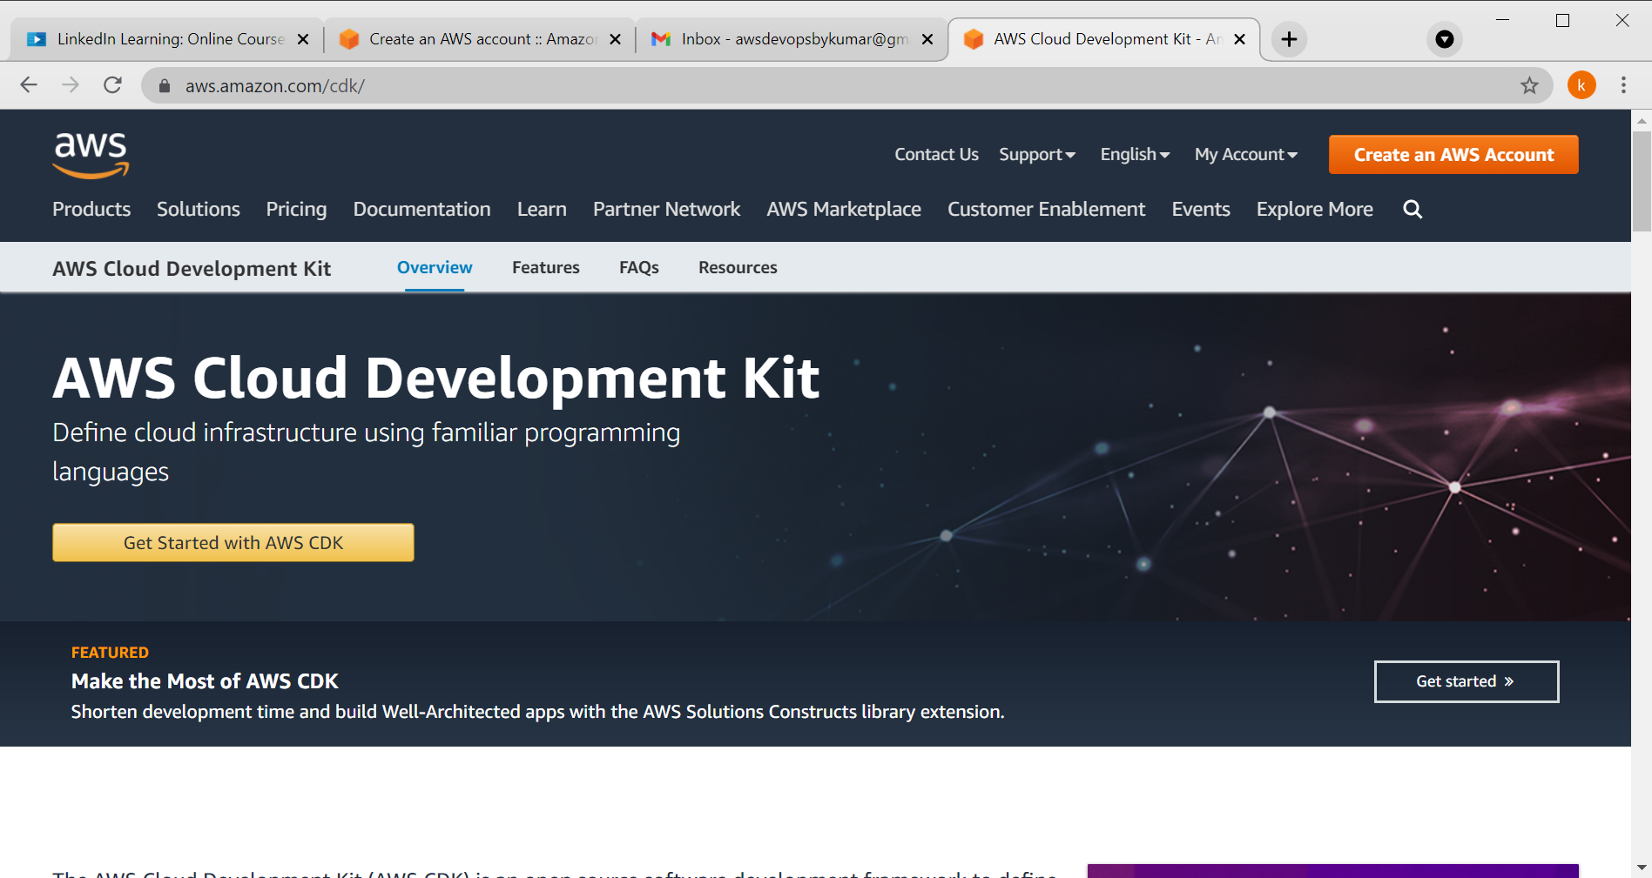

Slide 2


Slide 3
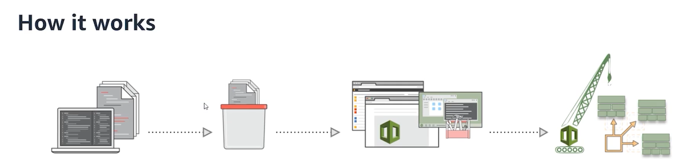

Slide 4
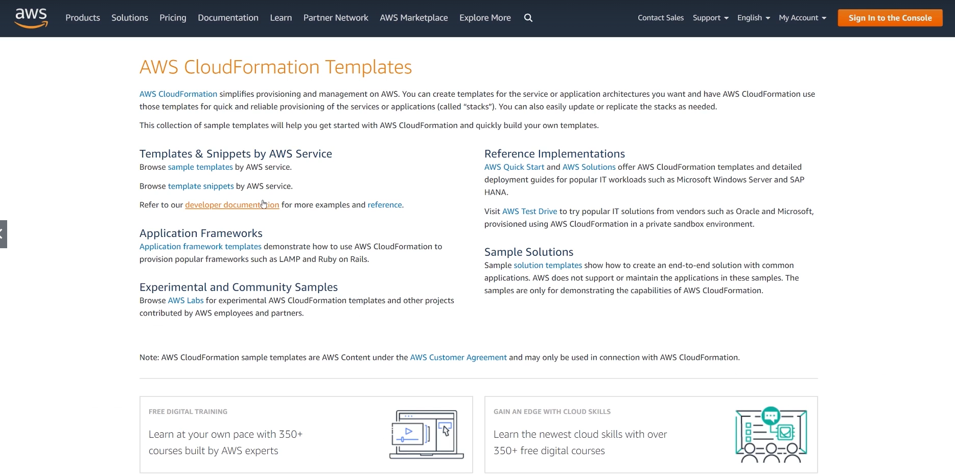

Slide 5
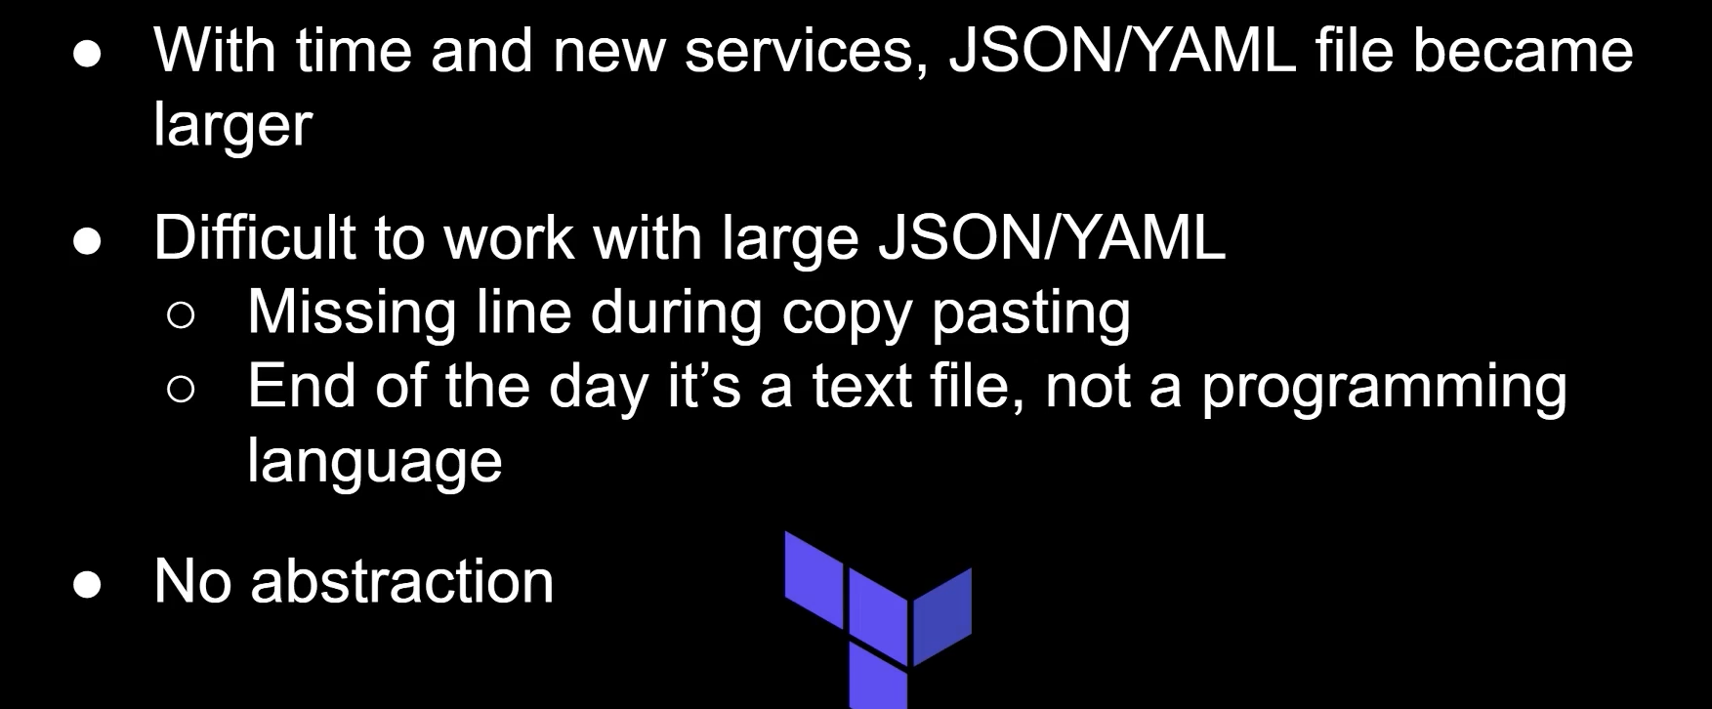

Slide 6
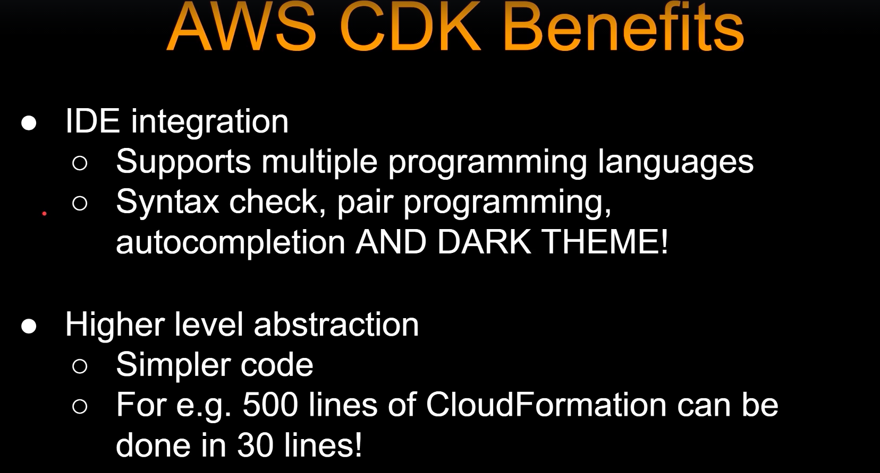

Slide 7
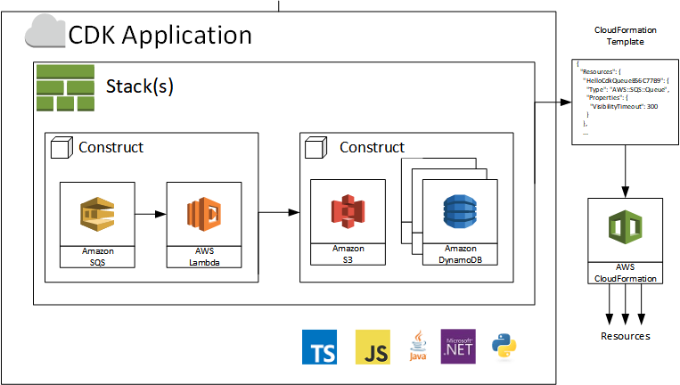
Notes:
AWS Cloud Development Kit (CDK) – TypeScript and Python are Now Generally Available | AWS News Blog (amazon.com)

Slide 8
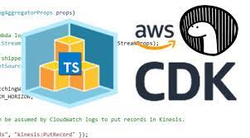

Slide 9
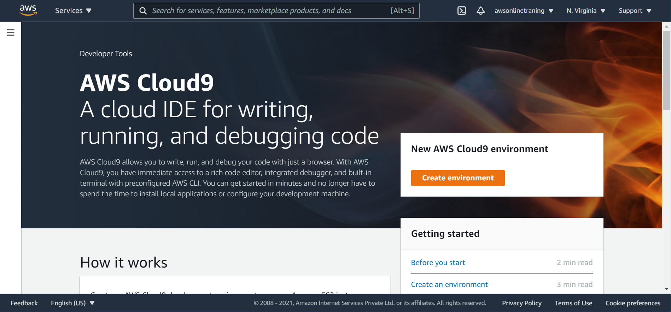
Notes:
https://aws.amazon.com/cloud9/pricing/

Slide 10
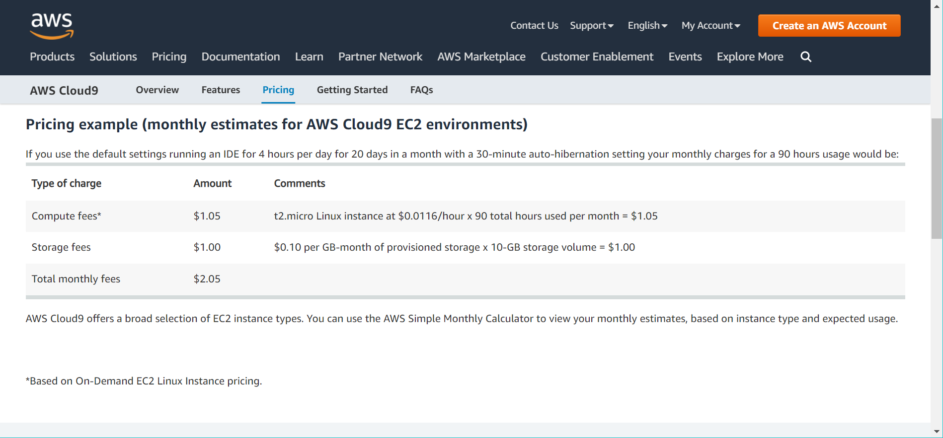
Notes:
https://aws.amazon.com/cloud9/pricing/

Slide 11
C:\AWS-DevOPS\Traning-Vendors\Integrated Solutions\AWS Developer\Final\CDK-CloudFormation
Notes:
https://docs.aws.amazon.com/cloud9/latest/user-guide/create-environment-main.html

